Slide 1
Evaluating Experience: Generative AI for Authentic Online Learning
Michael Rupert & Will Austin
Metropolitan State University of Denver

Slide 2
Experiential Learning in Online Classes
  What disciplines need/ could benefit from interactivity
    Skill Based- Medical, nursing, counseling
    Impact- Sociology, Health and Human Services
    Professional Experience- Project Management
    What else??

Slide 3
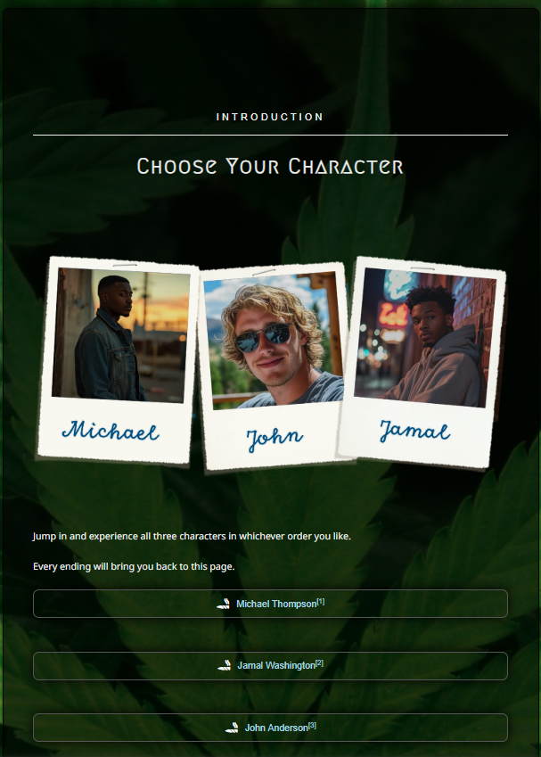
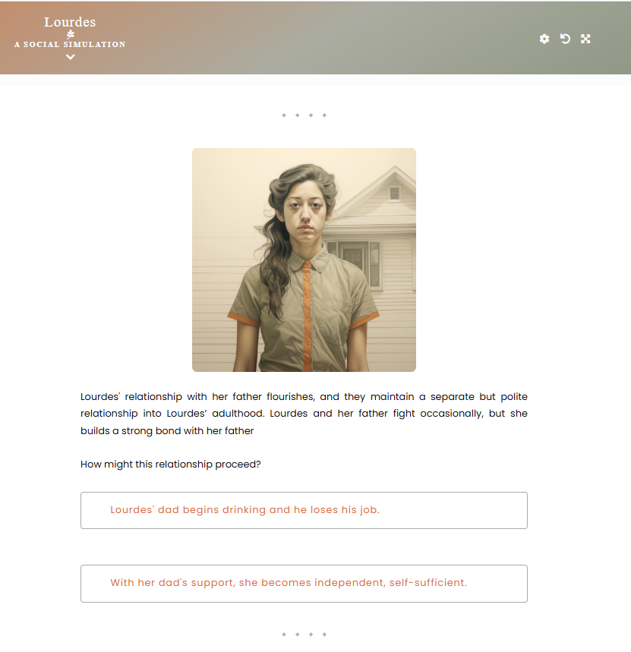
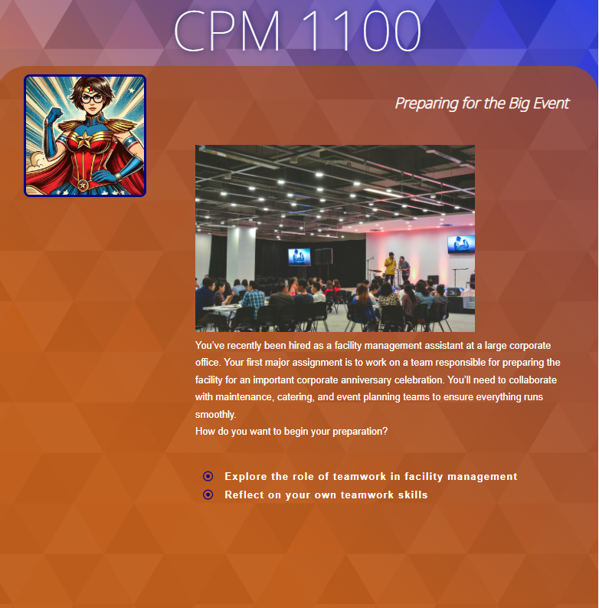
What we do
  “Choose Your Own Adventure” Styled experiences

Slide 4
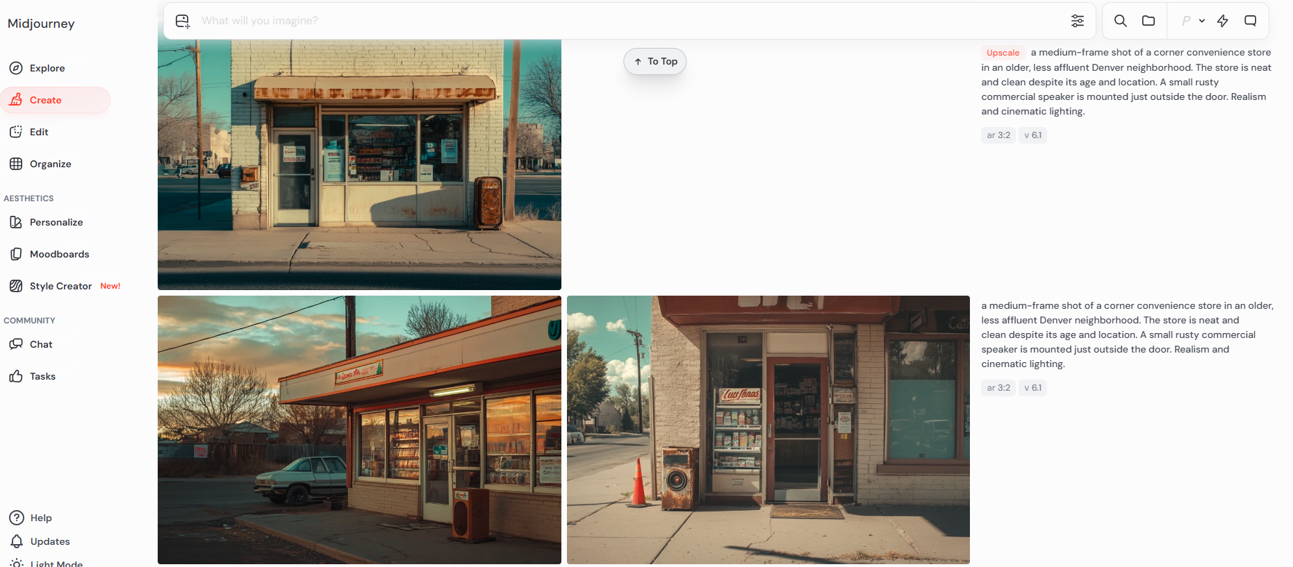
Technology- Media
Midjourney (best)
  ChatGPT and Sora (video)
  MS Copilot?

Slide 5
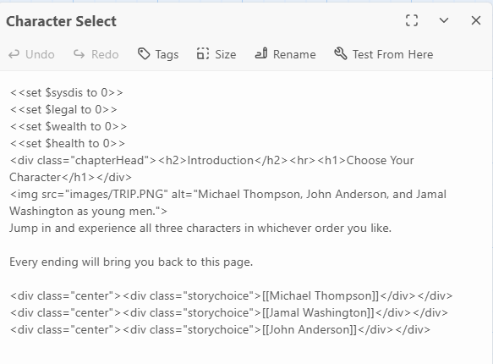
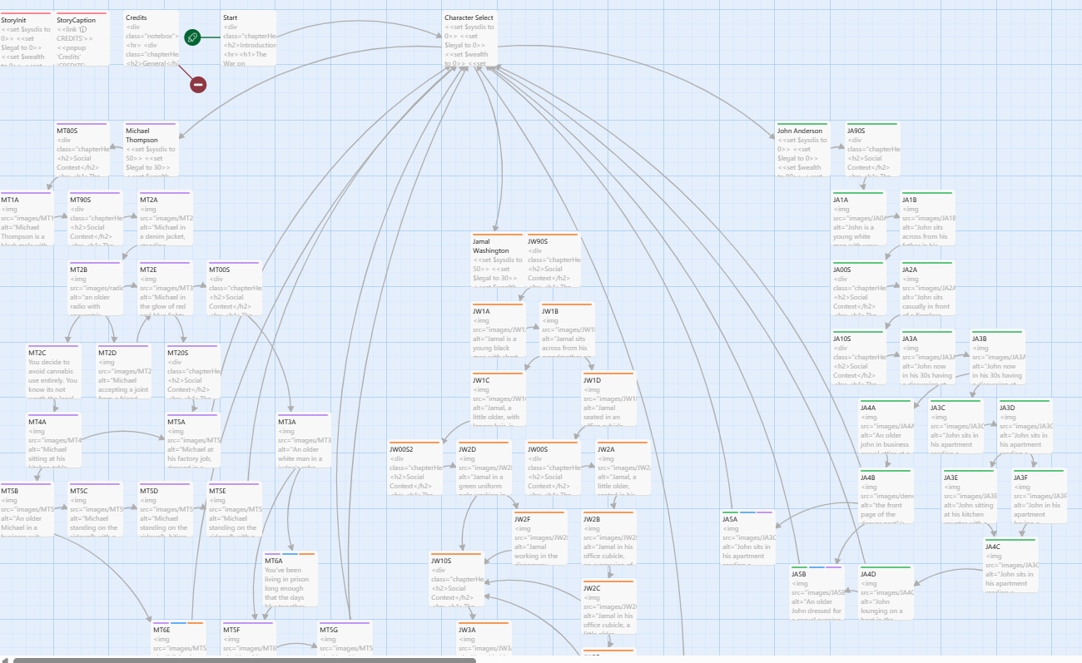
Technology- Building Experience
Twine
  HTML Story Builder

Slide 6
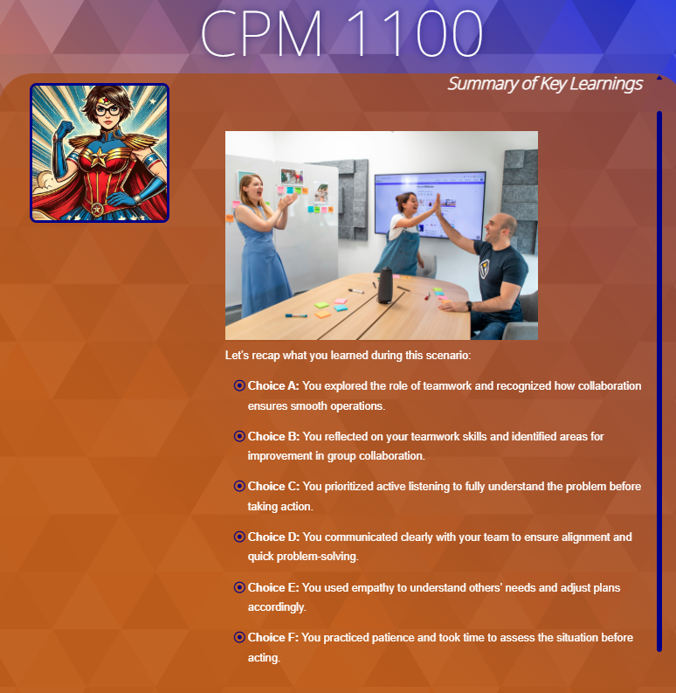
Assessment- how do we assess experiences?
  Recap and summary pages- revisit principles
  Reflections – what was the impact of the experience
  Quizzes – Discrete and Semantic knowledge

Slide 7
Higher Tech or Lower Tech?
  Lower tech (easier)
    Google Forms- Branching decisions without coding
    Public Domain Images (Unsplash, Pixabay)- Less customizable but doesn’t require AI
  Higher Tech (More experiential?)
    Twine HTML files can be zipped to work with Canvas, can talk to LMS (limited)
    AI Avatars like Heygen- provide visual and audio feedback

Slide 8
Discussion, Display, Demo
  Discussion
    What fields/ disciplines could benefit from interactivity?
    What knowledge is important and how do we assess?
  Display
    Look at existing Twine experiences
    Explore how experiences are placed in courses
  Demo
    Try to build your own Twine
    Midjourney prompting, storyboarding, zipping?

Slide 9
Evaluating Experience: Generative AI for Authentic Online Learning
Michael Rupert & Will Austin
Metropolitan State University of Denver

